Slide 1
Partition of India
SEM-IV, CC-10
DEBABRATA NANDI

Slide 2
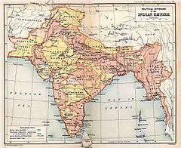

Slide 3
The partition of India in 1947 eventually accompanied the creation of two independent dominions, India and Pakistan.
The Dominion of India became, as of 1950, the Republic of India (India), and the Dominion of Pakistan became, as of 1956, the Islamic Republic of Pakistan (Pakistan). In 1971, the People's Republic of Bangladesh (Bangladesh) came into being after Bangladesh Liberation War

Slide 4
he partition involved the division of three provinces, Assam, Bengal and Punjab, based on district-wide Hindu or Muslim majorities. The boundary demarcating India and Pakistan came to be known as the Radcliffe Line.

Slide 5
Punjab
The Partition of British India split the former British province of Punjab between the Dominion of India and the Dominion of Pakistan. The mostly Muslim western part of the province became Pakistan's Punjab province; the mostly Sikh and Hindu eastern part became India's East Punjab state (later divided into the new states of Punjab, Haryana and Himachal Pradesh). Many Hindus and Sikhs lived in the west, and many Muslims lived in the east, and the fears of all such minorities were so great that the Partition saw many people displaced and much intercommunal violence. Some have described the violence in Punjab as a retributive genocide

Slide 6
Bengal
The province of Bengal was divided into the two separate entities of West Bengal, awarded to the Dominion of India, and East Bengal, awarded to the Dominion of Pakistan. East Bengal was renamed East Pakistan in 1955, and later became the independent nation of Bangladesh after the Bangladesh Liberation War of 1971.

Slide 7
After math of the partition
The partition displaced over 14 million people along religious lines, creating overwhelming refugee crises in the newly constituted dominions; there was large-scale violence, with estimates of loss of life accompanying or preceding the partition disputed and varying between several hundred thousand and two million.^{[1][c]} The violent nature of the partition created an atmosphere of hostility and suspicion between India and Pakistan that plagues their relationship to the present.

Slide 8
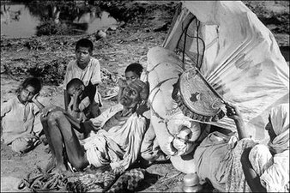
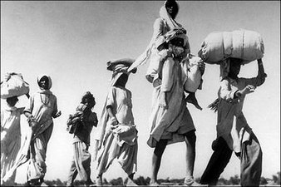

Slide 9
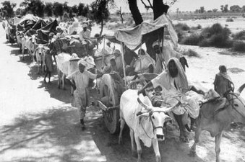
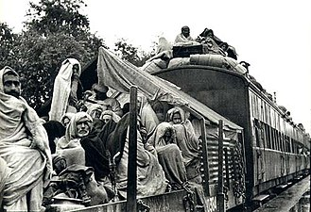

Slide 10
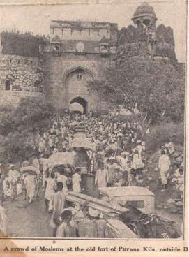
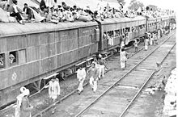

Slide 11
THANK YOU

